Slide 1
PIM – PDO Incident Management
Incident, Assurance, Audit Management Solution

Slide 2
PIM v6.2 Upgrade
Major Changes

Slide 3
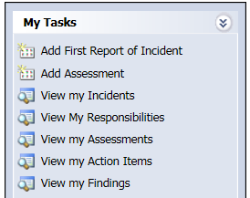
PDO_IMPACT_v6.2 Upgrade - System
Now you can navigate your (Incidents, Pending Responsibilities, Assessment, Actions and Finding) from the “My Tasks” menu.
The Application access authorities have been modified and higher access has been given to specific people based on business requirement

Slide 4
PDO_IMPACT_v6.2 Upgrade – Incident Module
"You are Here" workflow images.

Slide 5
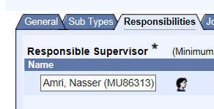
PDO_IMPACT_v6.2 Upgrade – Incident Module
The Incident Work flow title “Open” in the “Draft 2” status changed to “Submit to Incident Owner”.
The Incident “Responsible Supervisor” is added to the “Responsibilities” tab.

Slide 6
PDO_IMPACT_v6.2 Upgrade – Incident Module
Renamed the “Responsible Supervisor” field in the “General” tab to “Initial Responsible Supervisor” (Can not be modified)
Changing the Responsible supervisor’s name should be done from the Responsibilities tab.
The “Location” is a mandatory field for the incident entry.

Slide 7
PDO_IMPACT_v6.2 Upgrade – Incident Module
The “Third Party” incident, removed from the event type and now can be marked in the incident flag and consequences.
The Application will notify the Incident “Entered By” and the “Incident Owner” once the Incident is closed.
Implemented New Transportation Consequence Module and retired the old “ Vehicular Consequence”.

Slide 8
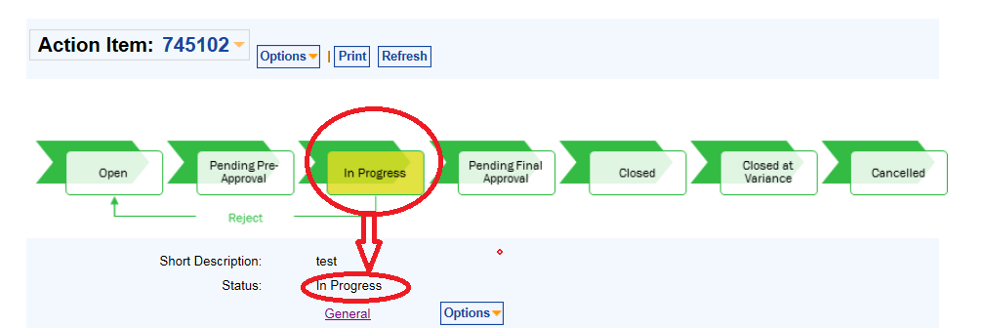
PDO_IMPACT_v6.2 Upgrade – Action Module
"You are Here" workflow images.

Slide 9
PDO_IMPACT_v6.2 Upgrade – Action Module
The “Post Action Approver” issue has been solved.
The Application will notify the Action Item “Entered By” once the action is closed.

Slide 10
For assistance:- 246-74106 / 75608

